Slide 1

Bias/Variance Trade-off
DATA ANALYTICS | IRONHACK

Slide 2



IRONHACK BOOTCAMP
Agenda
Introduce regression problem
Bias variance trade off
Credit: Unsplash

Slide 3
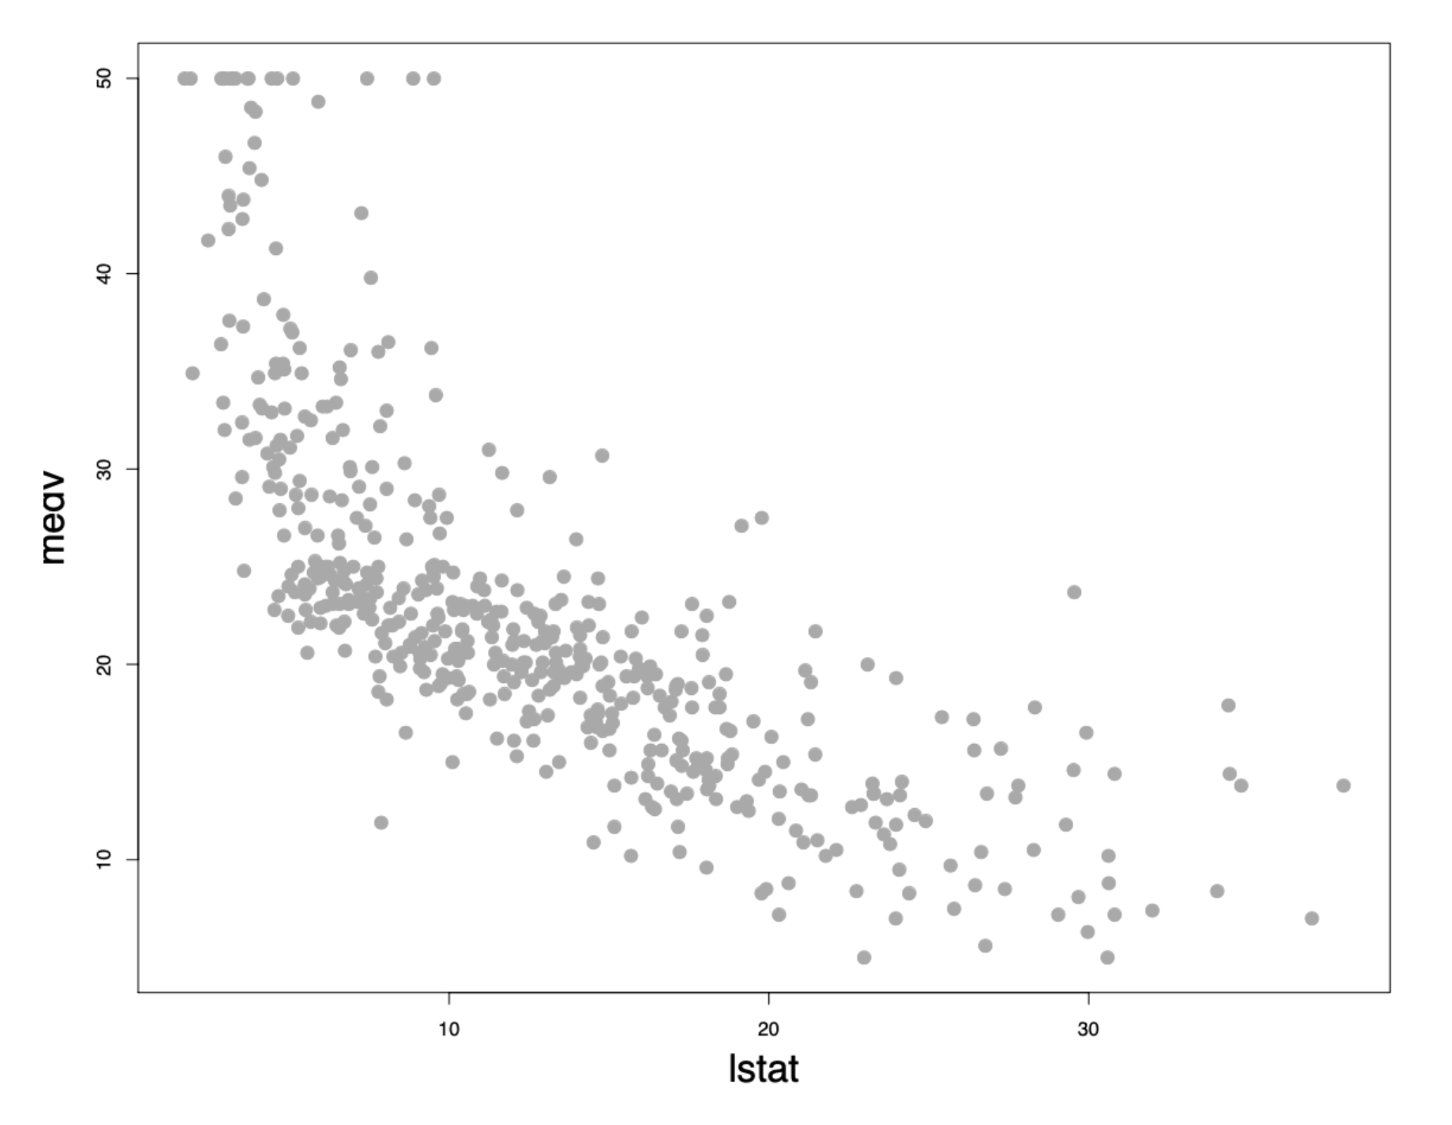
IRONHACK BOOTCAMP
Introducing
Regression Problem
Example
Problem:
Predict the median house value as a function of some measure of given social economic level (% lower status)
Each observation corresponds to a town in the given geography.

Slide 4
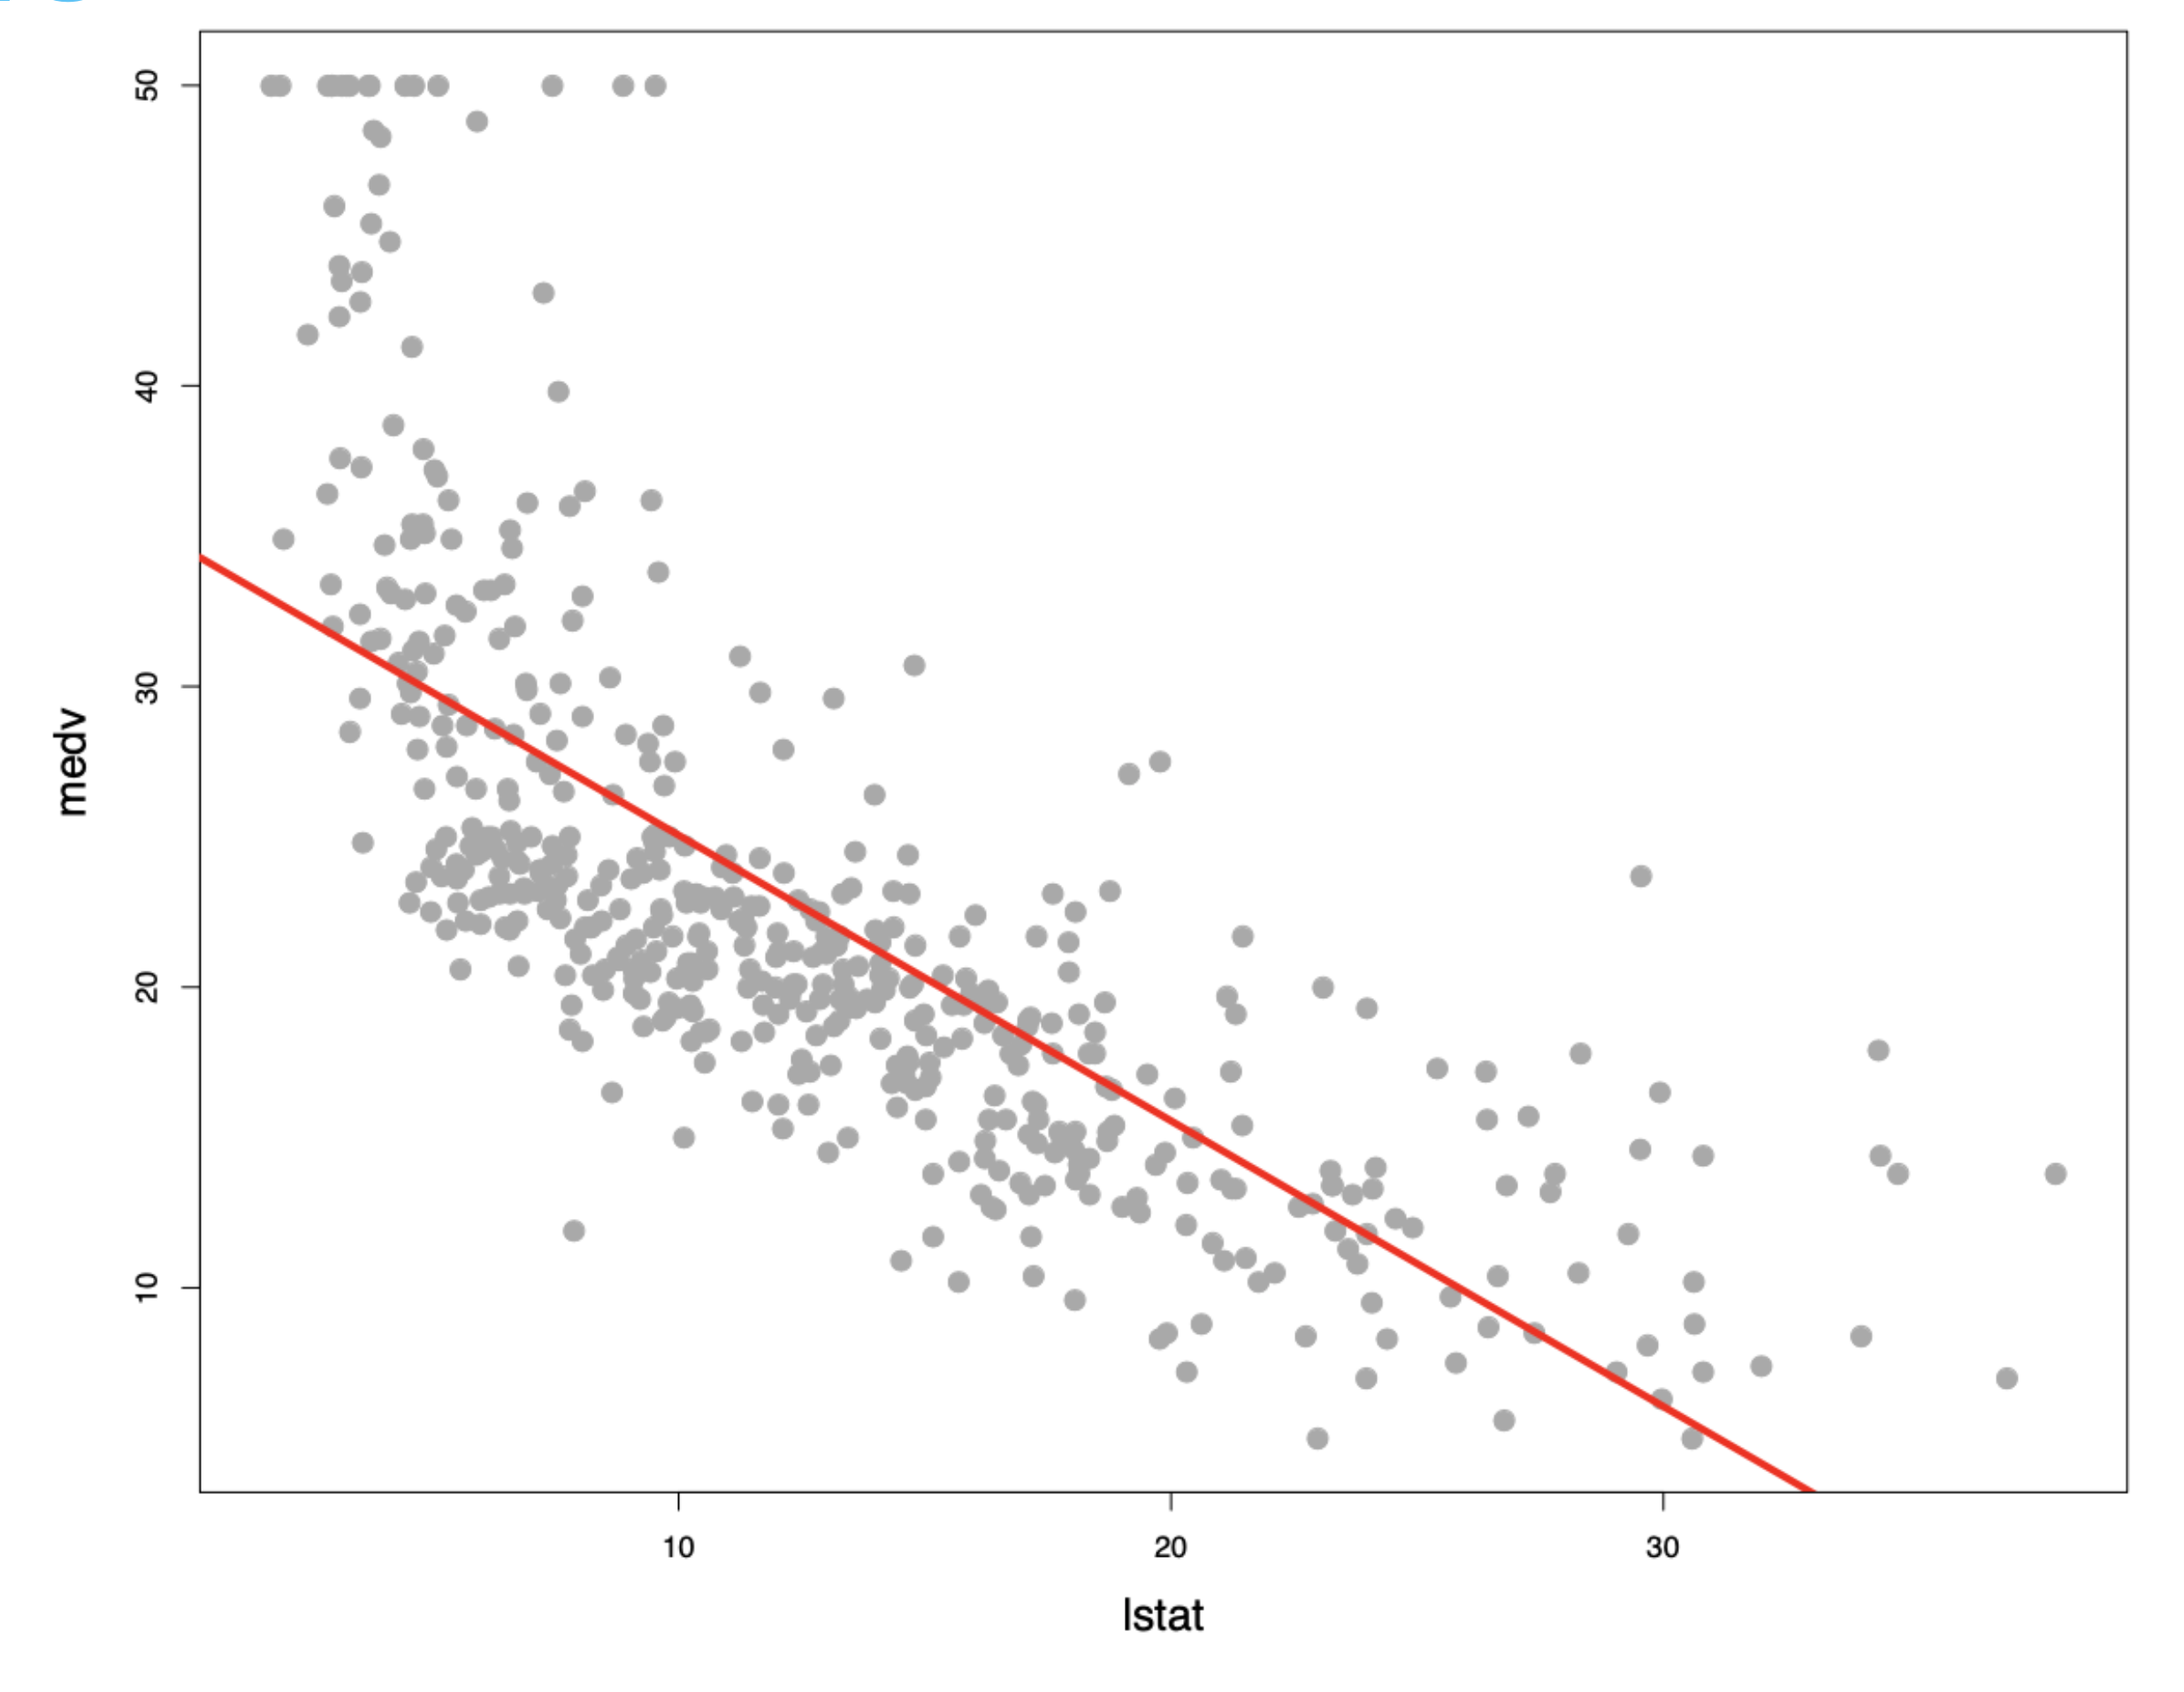
IRONHACK BOOTCAMP
Using Linear Regression To Predict Median House Value

Slide 5
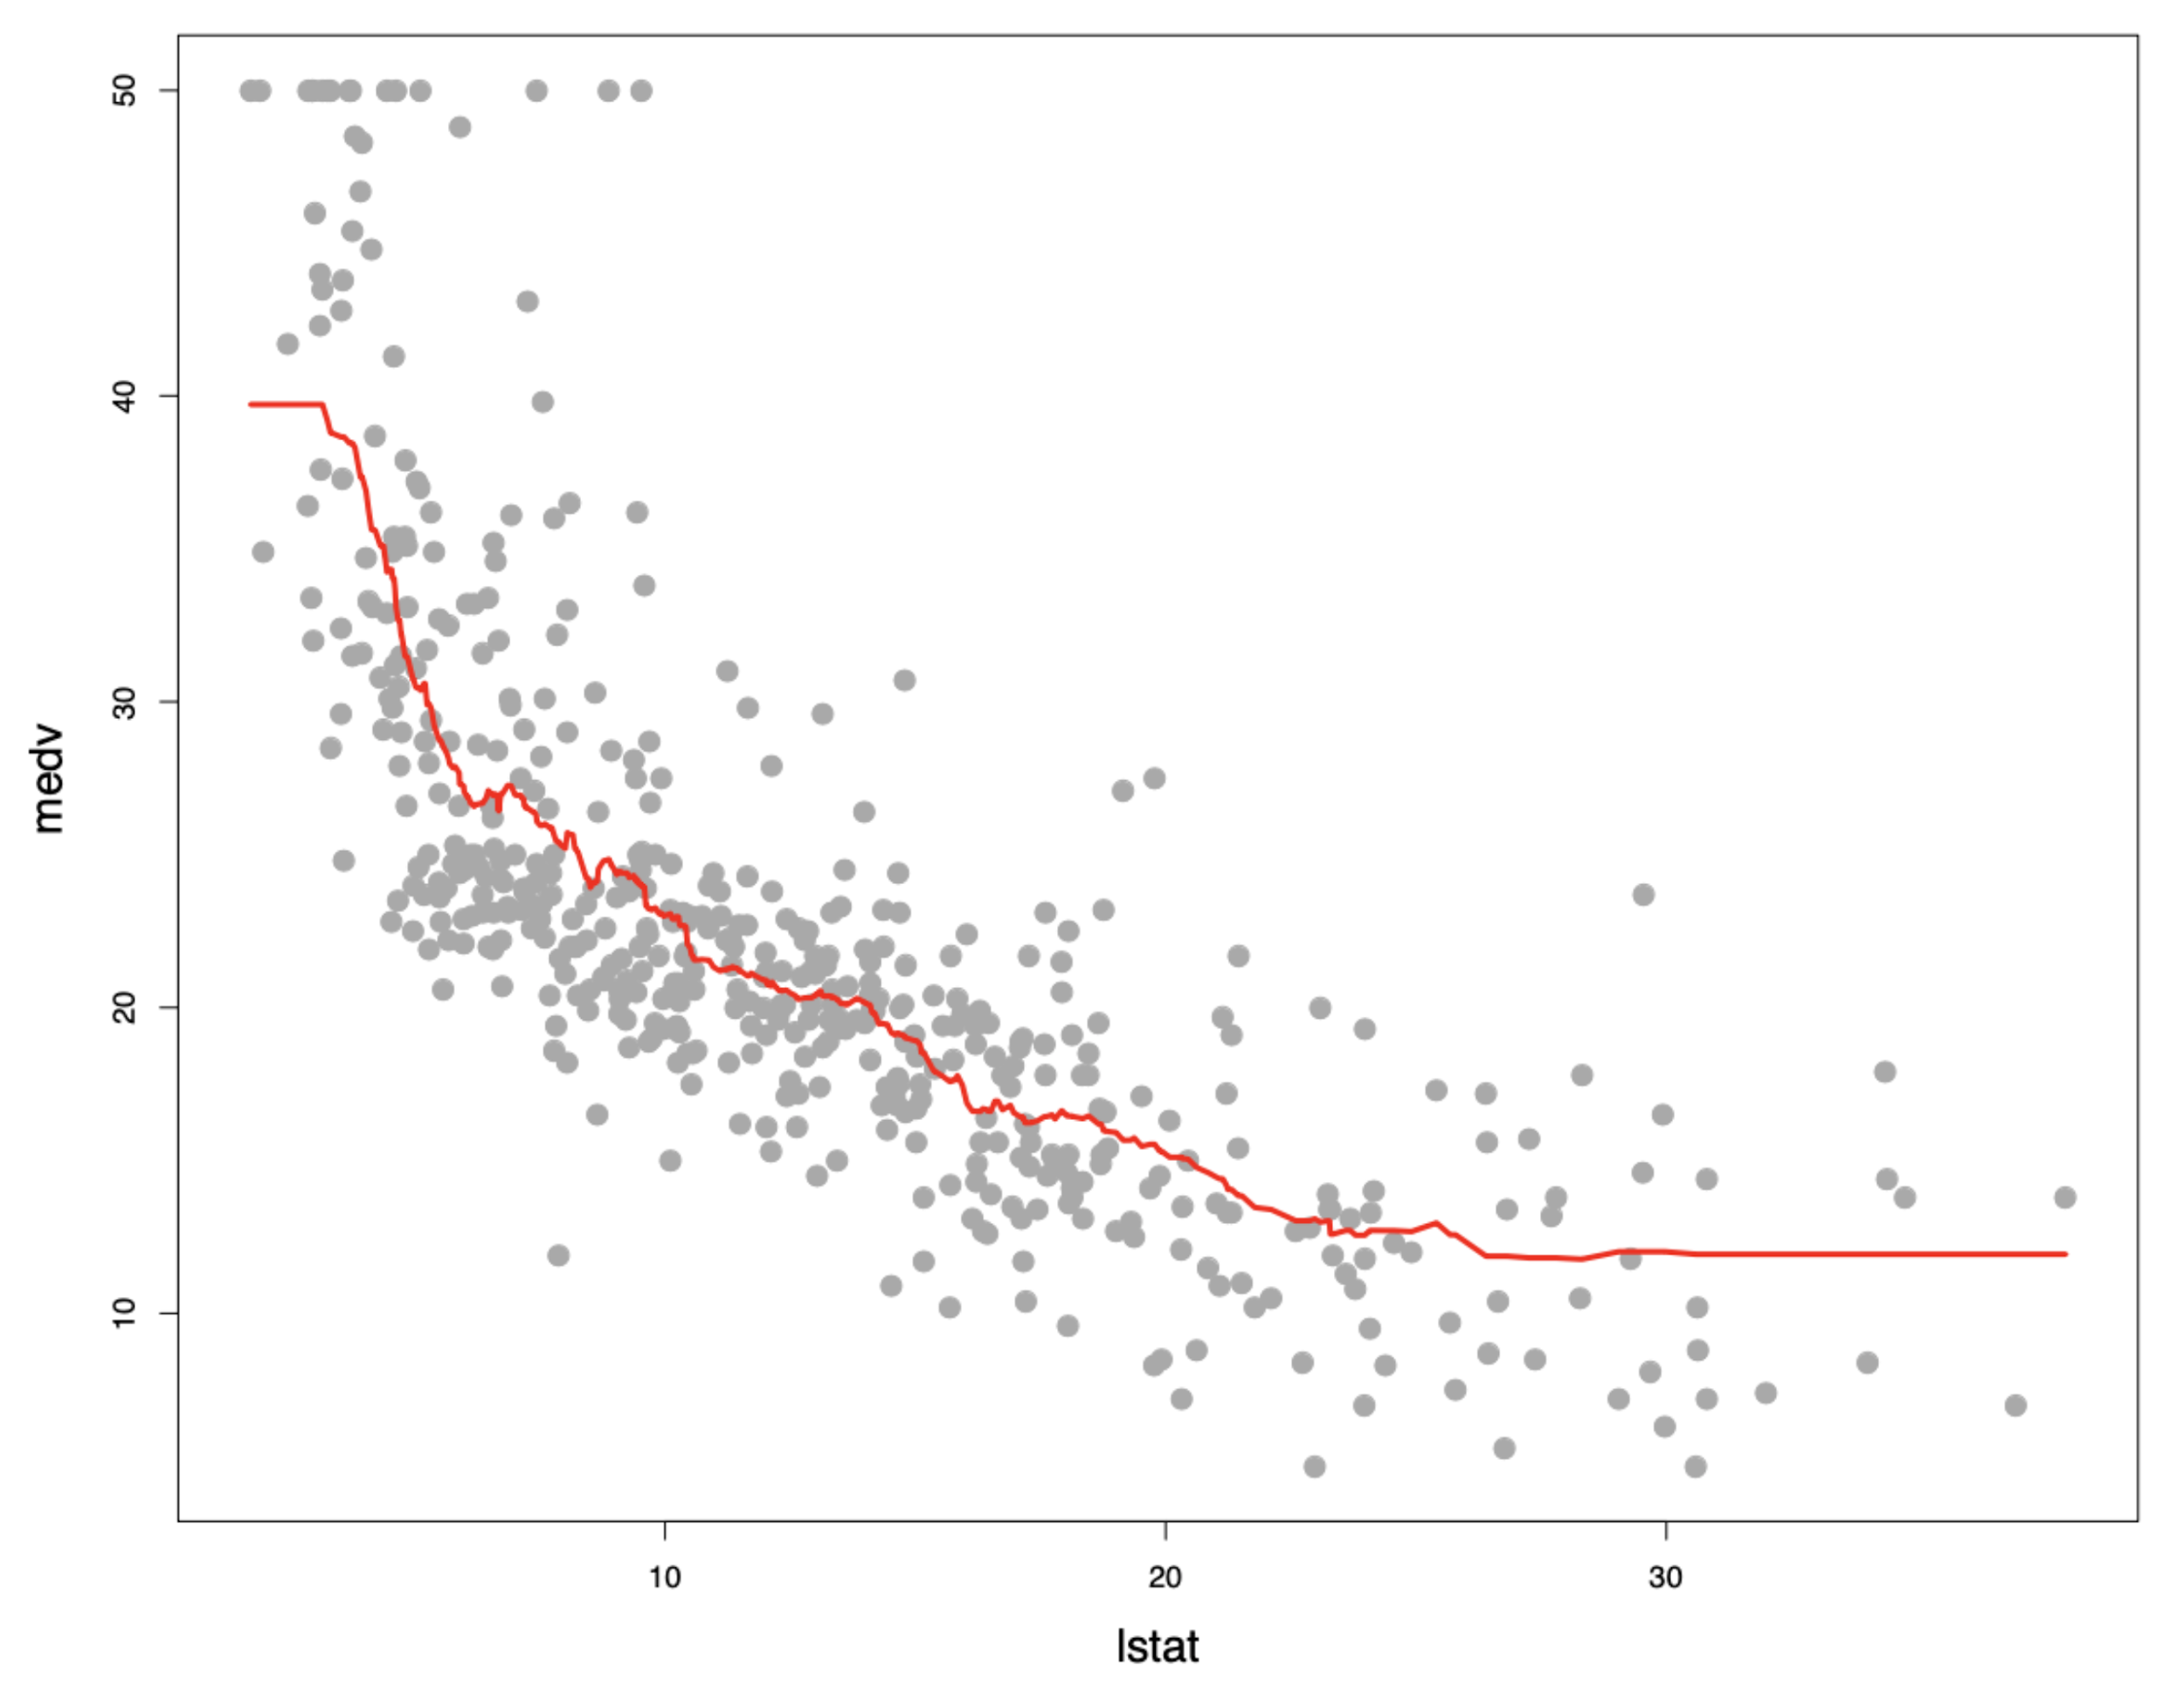
IRONHACK BOOTCAMP
Using KNN To Predict
Median House Value

Slide 6
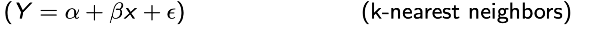
IRONHACK BOOTCAMP
KNN or Regression To Predict Median House Value
Parametric Model
Non-parametric Model

Slide 7

🤹🏽
BIAS / VARIANCE trade-off

Slide 8
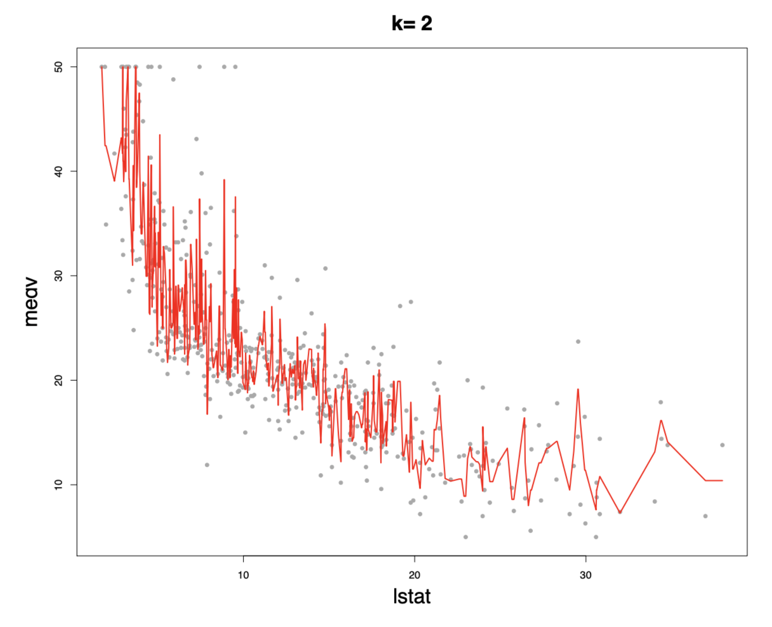
IRONHACK BOOTCAMP
BIAS/VARIANCE Trade-off
Prediction line is following
very closely with the actual data.
There is very high variance
Bias is very low
as there is less difference
between actual and predicted value

Slide 9
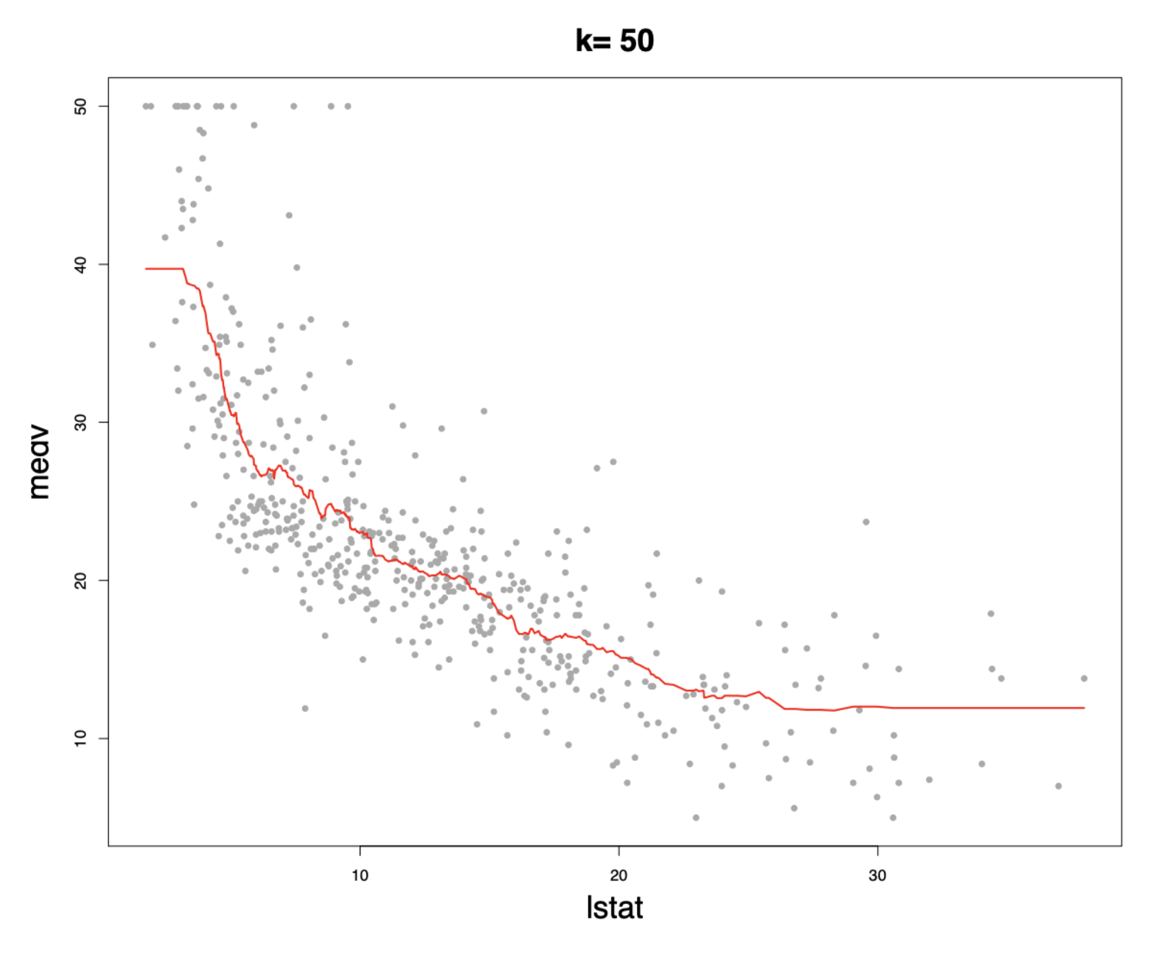
IRONHACK BOOTCAMP
BIAS/VARIANCE Trade-off
Prediction line is following
the actual data but
not as much as the previous case.
Variance is a lot lower
than the previous case

Slide 10
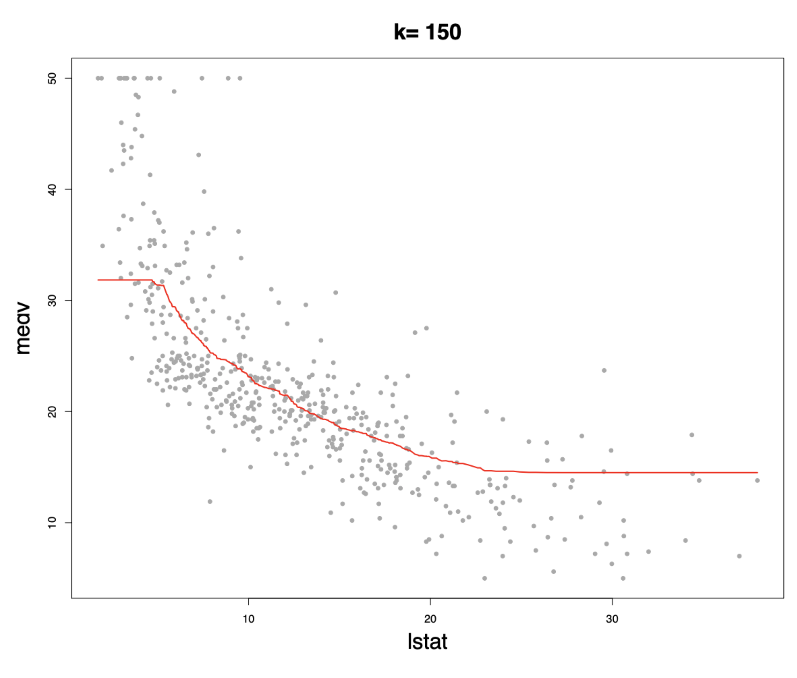
IRONHACK BOOTCAMP
BIAS/VARIANCE Trade-off
Prediction line is following
the actual data quite loosely.
Variance is lower
than the previous case
but bias is increasing

Slide 11
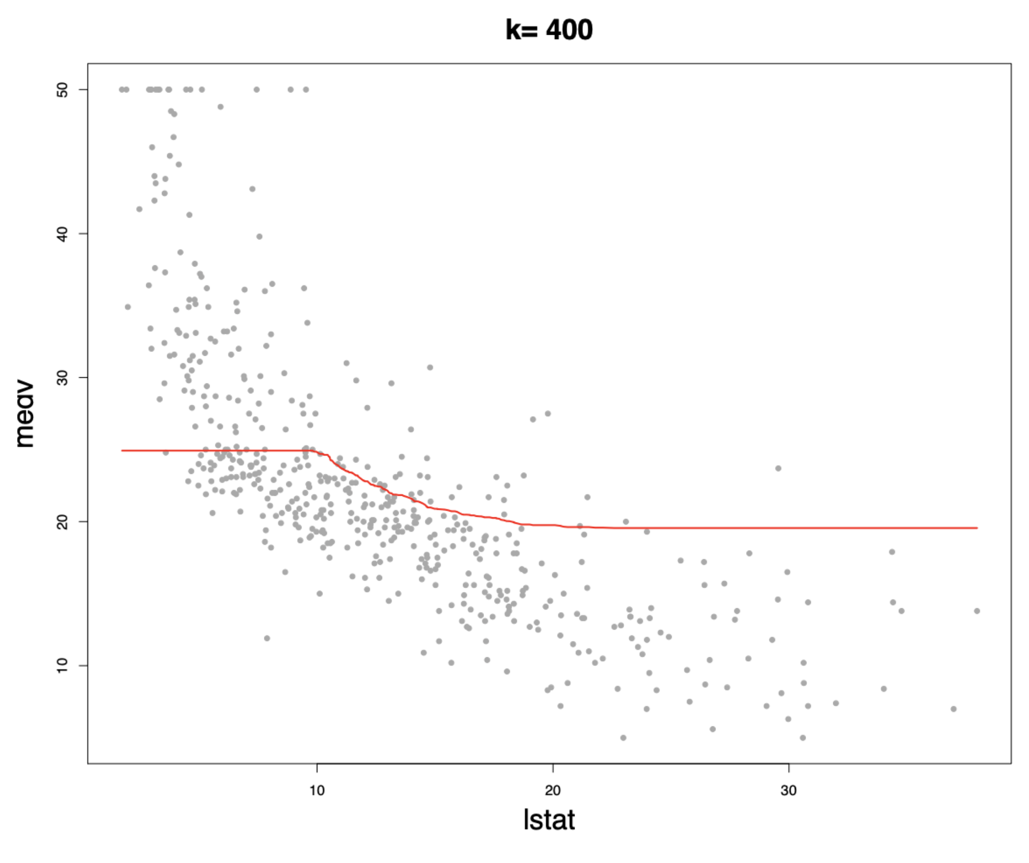
IRONHACK BOOTCAMP
BIAS/VARIANCE Trade-off
Prediction line is following
the actual data even more loosely.
While variance is slightly lower
than the previous case,
bias is increasing.

Slide 12
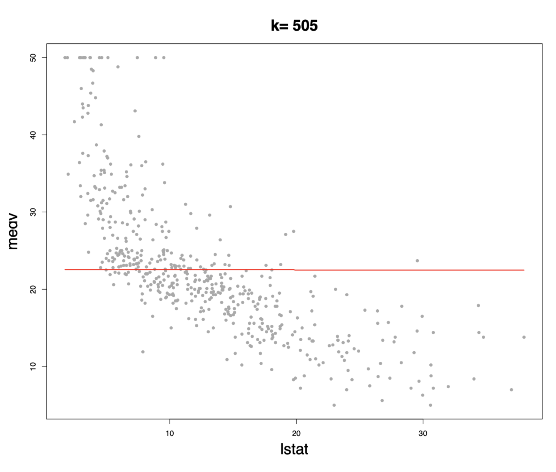
IRONHACK BOOTCAMP
BIAS/VARIANCE Trade-off
No variance
but
very high bias

Slide 13
IRONHACK BOOTCAMP
NOT TOO SIMPLE, BUT NOT TOO COMPLEX

Slide 14
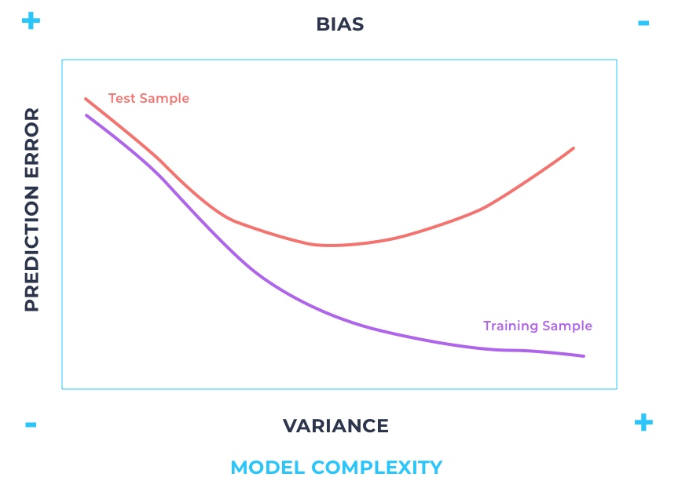
IRONHACK BOOTCAMP
Takeaway

Slide 15


